Slide 1
The mental timeline
Imagine I told you to draw a timeline of Hong Kong history. You draw a line, and at different points on the line you write down some significant events in Hong Kong history.
How would you draw this?
1

Slide 2
1842: HK ceded to British Empire
1941-45: Japanese occupation
1997: handover to China
2019-20 protests

Slide 3
The preceding example was very oversimplified, but it illustrates something important: We often think of time as flowing from the left (the past) to the right (the future).

Slide 4
Time and space
PAST
PRESENT

Slide 5
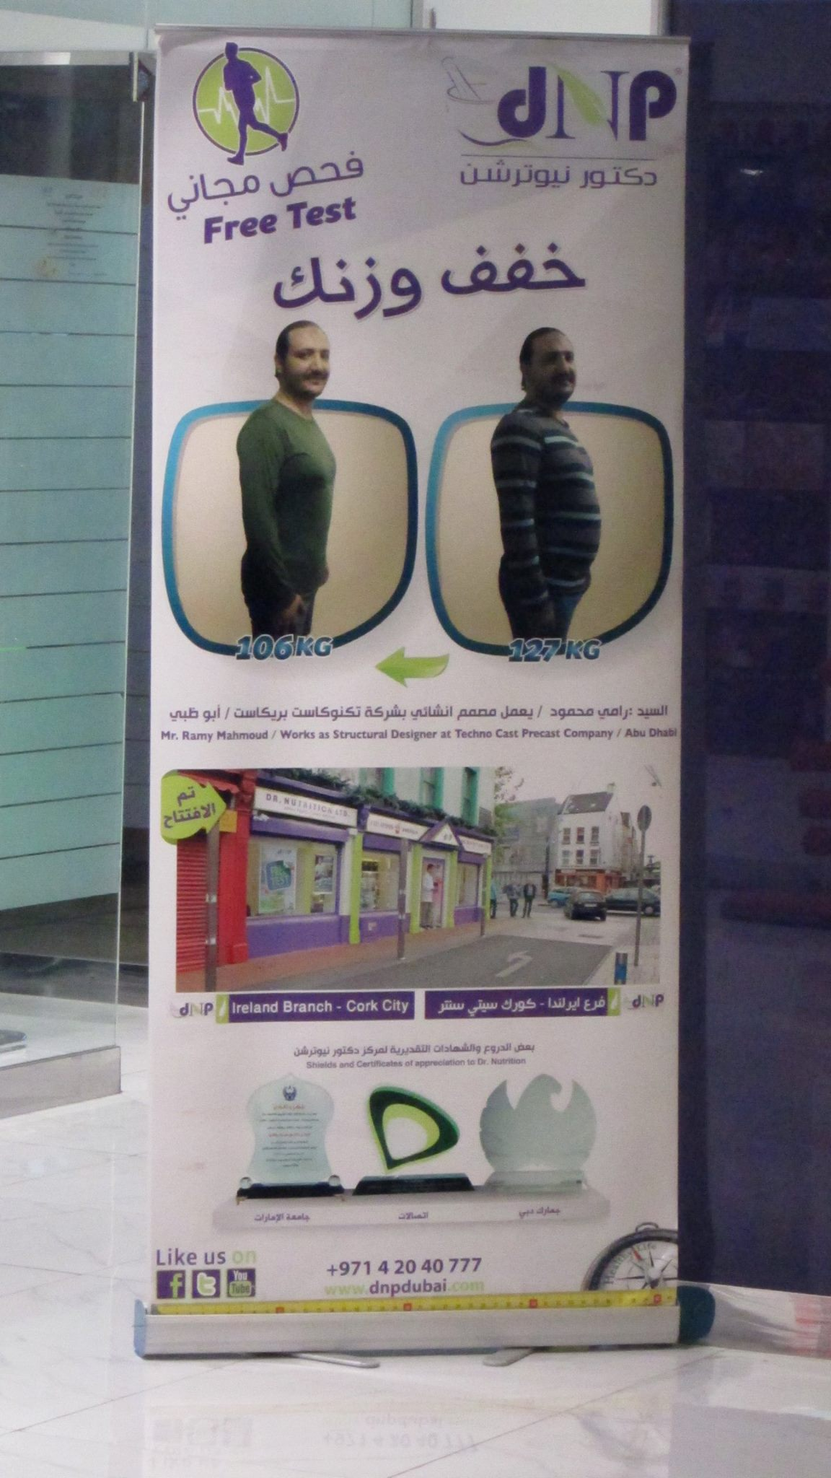
This “mental timeline” could be different for different people. For example, for Arabic speakers, the timeline may go from right to left instead of left to right (note that Arabic writing is also right-to-left). The photo here is an advertisement I saw in Abu Dhabi for diet pills. The “before” picture is on the right and the “after” picture is on the left. (The first time I saw it, as an English speaker, I misunderstood it as an advertisement for pills to make you fat!)

Slide 6
How might things be different in Chinese?

Slide 7
Time and space
PAST
PRESENT

Slide 8
In Chinese there are terms like 下个月 (“next month”, literally “the month below”)、下个礼拜 (“next week”, literally “the week below”) (and within Cantonese there are even more than in Mandarin, e.g. 上年/下年 [“last year”/”next year”, literally “above year”/”below year”]). So maybe Chinese speakers conceive of time as going from top to bottom?

Slide 9
Lera Boroditsky has done a bunch of experiments on this; they are controversial, and the results have not always been replicated, so what I will show here is just an interesting example but you should be aware this stuff is still an open question under debate. For more information you can see these old papers:
Fuhrman & Boroditsky (2010)
Ouellet et al. (2010)

Slide 10
In one experiment, participants would see two pictures. After the second picture, they would have to press a button (as quickly as possible) to indicate whether they think the second picture comes BEFORE or AFTER the first picture. For example, in the following example, they would have to press AFTER after the second picture.

Slide 11
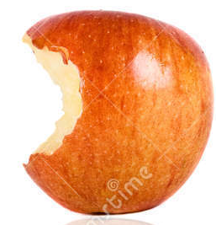

Slide 12
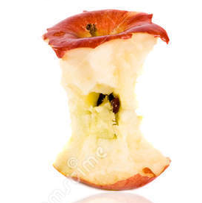

Slide 13
Whereas in the next example, they would have to press BEFORE…

Slide 15


Slide 16
What do you think they should press after the second picture in the next example?

Slide 17


Slide 18


Slide 19
But there is another twist in this experiment. Sometimes, the “BEFORE” button was on the left and the “AFTER” button was on the right. This matches how our “mental timeline” is arranged, and so it should be easy to press the button quickly. Other times, the “BEFORE” button was on the right and the “AFTER” button was on the left. Compared to our typical mental timeline, this is backwards! Because it’s confusing, we should be slow to press the button. That’s what happened, with both English speakers and Mandarin speakers:

Slide 20
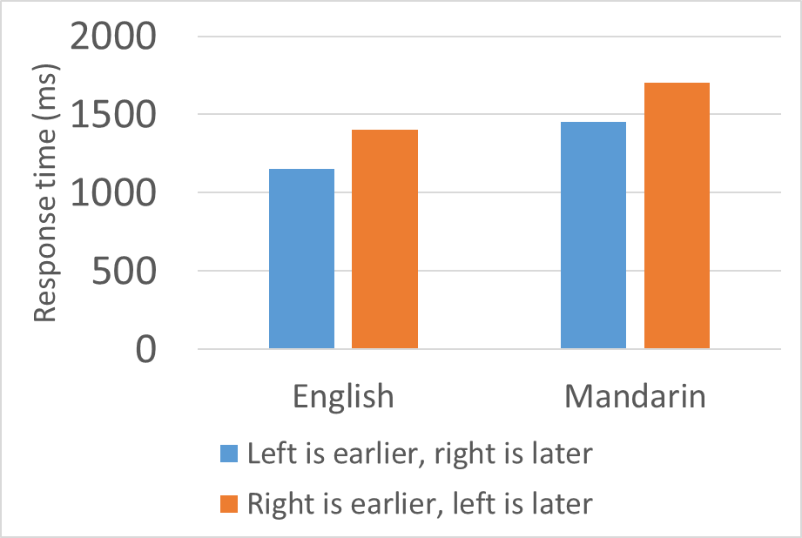


Slide 21
Now for the interesting part. They did another version of the experiment where the buttons were not on the right and left side of the keyboard, but were at the bottom and top (the keyboard was stuck up against a wall to be vertical).

Slide 22
For Mandarin speakers, it should be easy to respond quickly when the “BEFORE” button is at the top and the “AFTER” button is at the bottom, if Mandarin speakers really think of time as flowing from top to bottom. And it should be hard for them to respond when the buttons are switched, with “BEFORE” at the bottom and “AFTER” at the top.
For English speakers, there should be no difference, because English speakers don’t think about time as going from either top to bottom or bottom to top.

Slide 23
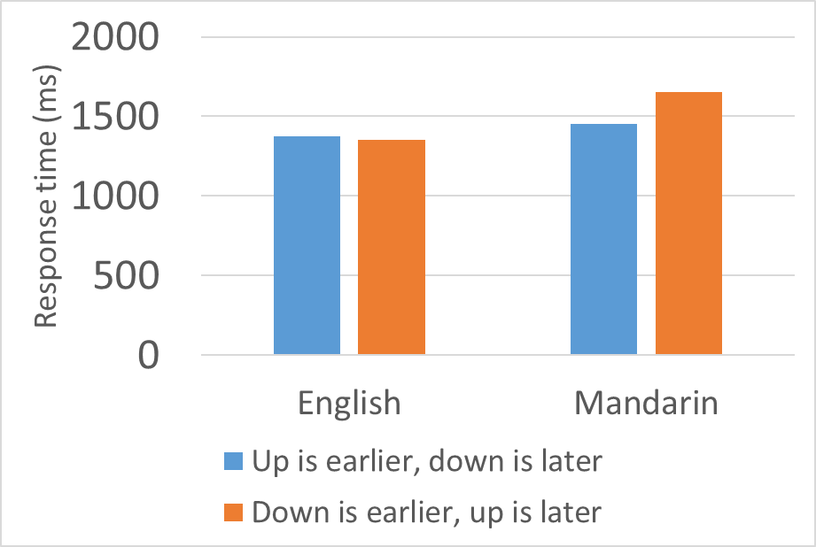

Slide 24
You can see from the previous graph that that’s exactly what they found. Mandarin speakers got slower when the up/down – before/after association was backwards. English speakers didn’t care.
The following slides show the whole experiment design and results together.

Slide 25
 | Horizontal | Vertical
Canonical | earlier later | earlier later
Non-canonical | later earlier | later earlier

Slide 26
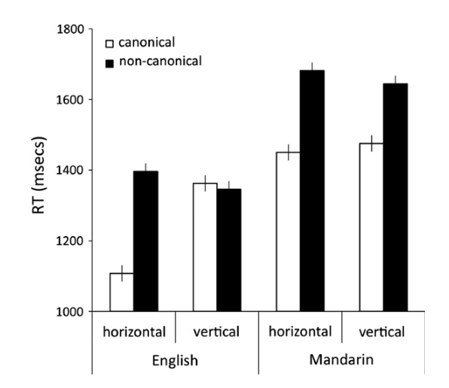

Slide 27
What this suggests is that Mandarin speakers really do think of time as flowing from top to bottom, whereas English speakers do not.
As I mentioned previously, this claim is controversial; what I’ve shown here is the results of one study, but there have been other studies with conflicting results.

